Slide 1
GNU/Linux System Support
CST8207
Week-1, Lecture-2
Sep 10th, 2025
By: Gurpreet Singh Sidhu

Slide 2
Major UNIX Operating System Components
Major components in all UNIX and UNIX “like” operating systems versions are the:
Regardless of the UNIX “flavor” you are using (e.g Linux, BSD, Solaris, etc.) they all have very similar functionality
Hardware
Kernel
File System
Shell
Utilities

Slide 3
KERNEL
The kernel is the core (e.g. nucleus) of any UNIX or UNIX “like” operating system
The kernel provides basic services for the rest of the operating system by supporting functionality such as:
- Multi-tasking
- File I/O
- Connectivity to networks and devices
- Resource allocation
Often, the only major difference between (2) UNIX or UNIX “like” nodes, is which kernel version they run

Slide 4
FILE SYSTEM
EVERYTHING is a file
Unix/Linux files are organized within a single-tree hierarchical file system structure made up of files containing data (e.g. documents, programs), and directories (folders) that may contain other sub-directories and files.
Unlike Windows with separate multiple drive letters (A:, B:, C:, etc.) for each disk partition, the Unix/Linux file system hides the physical disk structure and has a single tree root, no matter how many disks or partitions are actually in use. There is no way to tell on what disk partition a Unix/Linux file resides by looking at its name.

Slide 5
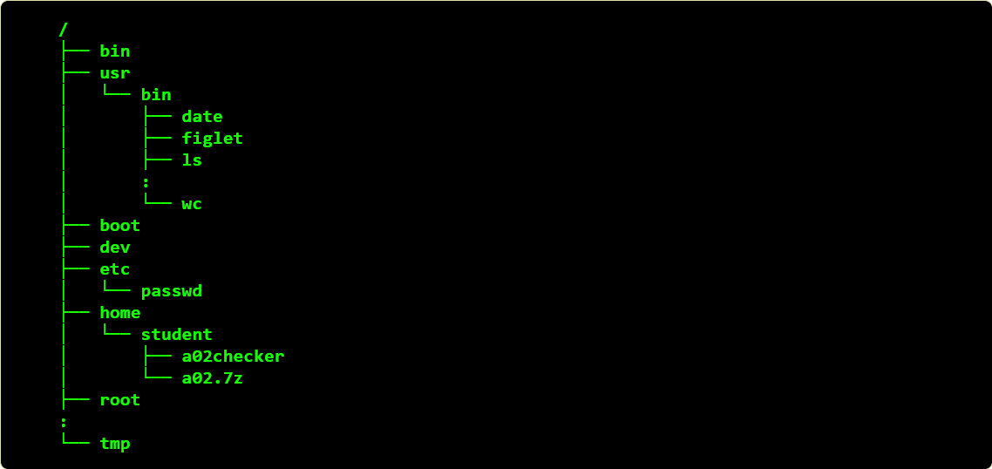
File System Structure

Slide 6
SHELL
SHELL is a program.
Provides a command-line interface where the user can execute commands.
Command interpreter, acts as a interface between you and the kernel.
When you enter command on terminal, the shell interprets the command and calls the program you want.
The shell knows nothing about how the ls command works. The shell only knows that you want to find and run the command.
For example:- when we enter command ls, shell looks for ls and calls ls program/utility

Slide 7
There are several popular UNIX and UNIX “like” shells available
Bourne Shell (sh) – Secure shell
C Shell (csh) – (aliasing, command history feature)
Korn Shell(ksh) – (very powerful- superset of Bourne shell, command line editing eg- vi)
Bourne-Again Shell(bash) /bin/bash
etc
(bash) is the lead in the shell market

Slide 8
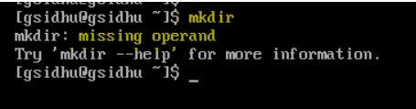
Syntax for simple command
command [arg1] [arg2].... [argn] Enter/RETURN
➢ Some Linux commands consist of only the name of the command without any argument.
Example 1, ls By itself lists the content of the working directory.
➢ On the other side some commands that require arguments typically give short error message when typed without argument
Example 2:- mkdir (stands for Make directory, Used to create/make new directory)

Slide 9
Argument
On Command line each sequence of nonblank character is called a token or word. An argument is a token that a command acts on (eg: name of file or directory, string of characters or a number)
Example 3:- cp temp backup (this command line uses command cp to copy the file named temp to directory backup)
cp- is command (stands for copy, used to copy the files or directory)
temp is 1st argument
backup is 2nd argument

Slide 10
Options
Options – is an argument that modifies the efforts of a command or make command to get specific results.
Options are specific to and interpreted by the program that command line calls.
Example 4:- ls -a
In the above example ls is treating -a as an option, because it starts with dashes and dashes are interpreted by ls command as options.

Slide 11

Command Argument and options
NOTE- The command decides if an argument is an option, depends on the command doing the interpretation.
We can make use of combination of option and argument based on our need to perform any function
Example 5 - ls –a week2lec
In this example from the point of view of shell, shell is given 2 arguments, however from the point of the ls command, -a argument is interpreted as option because it starts with dashes and dashes are interpreted by ls command as options and week2lec is argument.

Slide 12
Some basic commands
pwd – show present ( current ) working directory
ls – list directory content
mkdir – create one or more new empty directories
touch – create an empty file
cd – change directory
rm – delete a file
mv – Rename/Move a file
rmdir – remove empty directories
rm –r – remove files or non empty directories

Slide 13
pwd Command
Shows which current working directory
Usage:
$ pwd

Slide 14
ls Command
Use- list directory content
Usage:
$ ls
$ ls -a -l
$ ls –al
-l : show detail info of file/directory
-a: show hidden files. (think of this : why a file might need to be hidden?)
-al : combine usage of –l and –a option List all files and directories
(including the hidden ones) located at my current directory context.
Next Slide shows the output ( Practice that on your Linux Box)

Slide 15
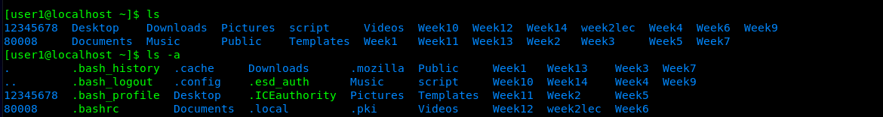
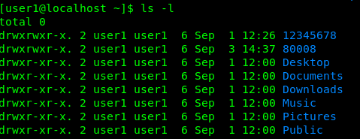
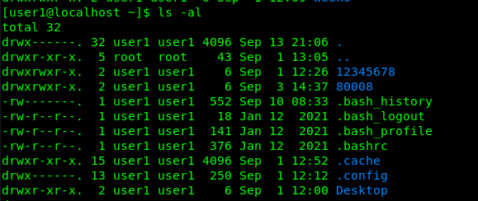

Slide 16
cd Command
Used to change your current directory context
The (cd) utility is used to change your current directory context
Demo :- (use of .. and .)
Usage:
$ cd
takes you to your home directory
$ cd ~
another way to go to your home directory
$ cd week2
change directory to “week2” just below my current directory context

Slide 17
cp Command
Copy files or directories
Syntax
$ cp [options] source destination
Options
-i Prompt before overwriting files
-r, -R copy directories and their contents
Live Demo

Slide 18
mv Command
mv stands for move. mv is used to move one or more files or directories from one place to another in a file system like UNIX. It has two distinct functions:
(i) It renames a file or folder.
(ii) It moves a group of files to a different directory.
Syntax
$ mv [Option] source destination
Options
-i (Interactive): Like in cp, the -i option makes the command ask the user for confirmation before moving a file that would overwrite an existing file.
Live Demo

Slide 19
mkdir Command
mkdir command in Linux allows the user to create directories.
This command can create multiple directories at once as well as set the permissions for the directories.
It is important to note that the user executing this command must have enough permissions to create a directory in the parent directory, or he/she may receive a ‘permission denied’ error.
Syntax:
mkdir [options..] [directories….]

Slide 20
mkdir Command
Options
-p: A flag which enables the command to create parent directories as necessary. If the directories exist, no error is specified.
Example –
mkdir -p first/second/third
If the first and second directories do not exist, due to the -p option, mkdir will create these directories for us. If we do not specify the -p option, and request the creation of directories, where parent directory doesn’t exist, we will get the following output

Slide 21
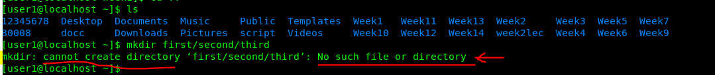
mkdir Command

Slide 22
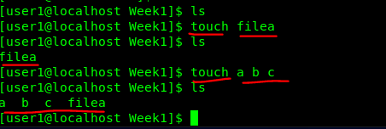
touch Command
Used to create a file without any content. The file created using touch command is empty. This command can be used when the user doesn’t have data to store at the time of file creation.
Syntax
$ touch filename

Slide 23
rm command
rm removes references to objects from the filesystem, where those objects might have had multiple references (for example, a file with two different names).
NOTE:- By default, it does not remove directories.
Syntax
$ rm [OPTION]... FILE...
-r (Recursive Deletion): With -r(or -R) option rm command performs a tree-walk and will delete all the files and sub-directories recursively of the parent directory. At each stage it deletes everything it finds. Normally, rm wouldn’t delete the directories but when used with this option, it will delete.

Slide 24
rmdir Command
rmdir command is used remove empty directories from the filesystem in Linux.
The rmdir command removes each and every directory specified in the command line only if these directories are empty.
So if the specified directory has some directories or files in it then this cannot be removed by rmdir
Syntax
$ rmdir [Option] directories …

Slide 25

echo command
Used to display line of text/string that are passed as an argument

Slide 26
cat Command
It reads data from the file and gives their content as output. It helps us to create, view, concatenate files.
Syntax
$ cat filename
$ cat file1 file2
Option
-n :- To view contents of a file preceding with line numbers

Slide 27
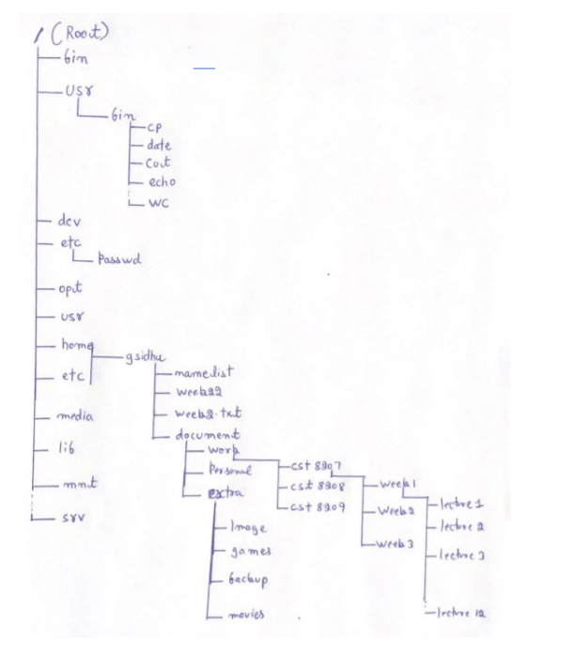

Slide 28
THINGS TO DO FOR NEXT CLASS
Finish Assignment 1 (Set up your Linux Box)
Go through Lecture slides.
Have a look at Assignment 2 (get prepared)

Slide 29
Questions ?

